Slide 1
PHYSICAL FACILITIES - LABORATORIES

Slide 2
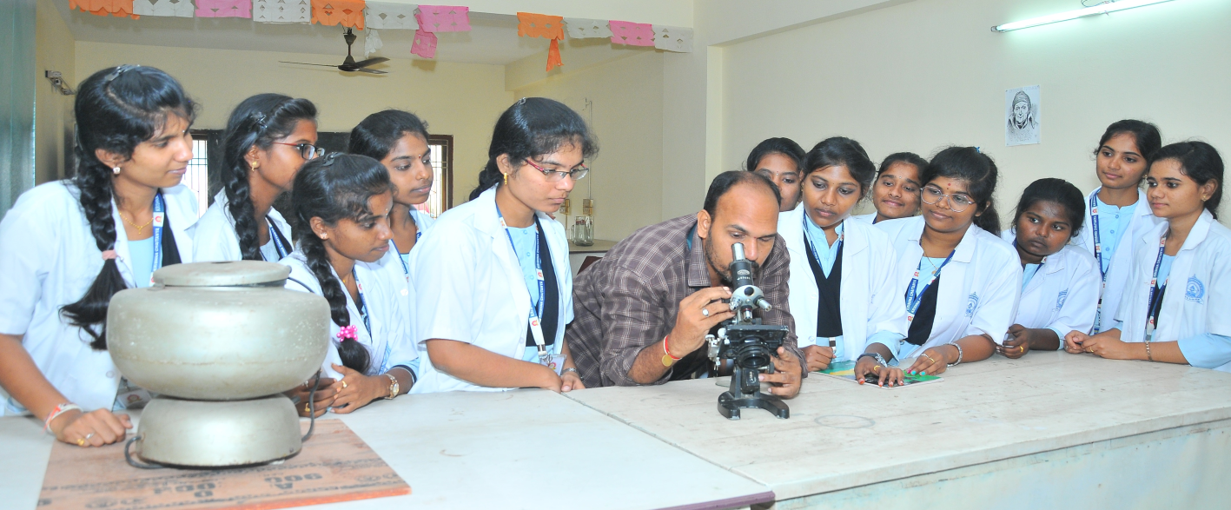
Students performing experiments in Biotechnology Lab

Slide 3
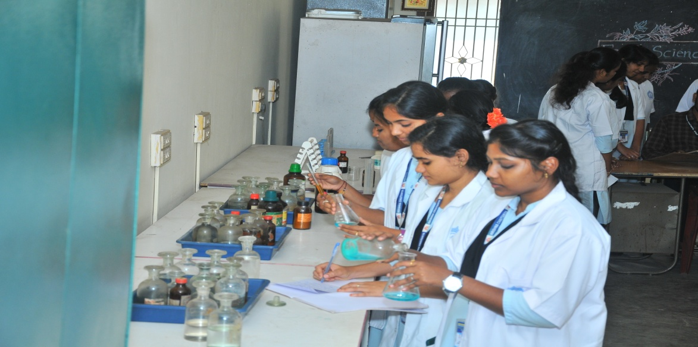
Students performing experiments in Chemistry Lab

Slide 4
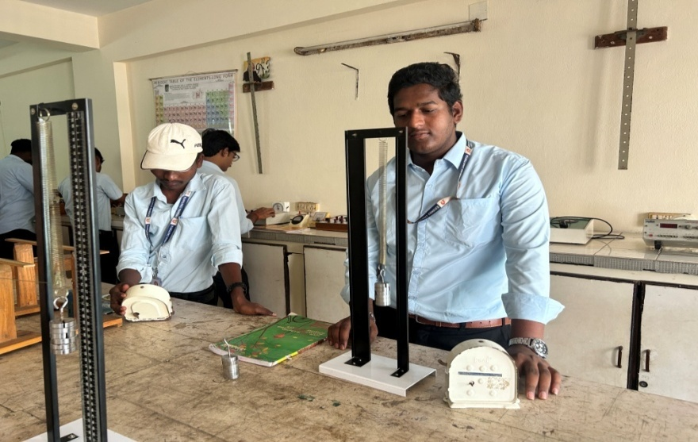
Students performing experiments in Physics Lab

Slide 5
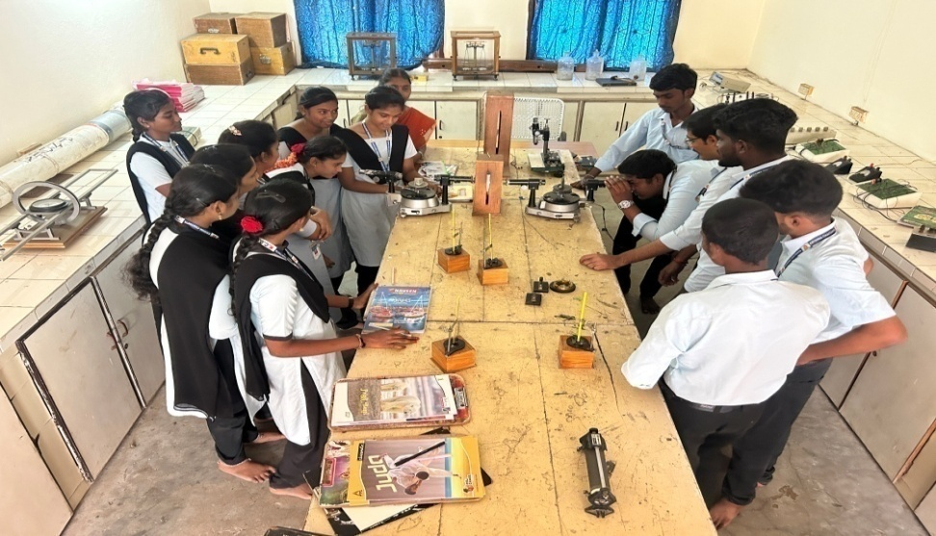
Physics Laboratory - overview

Slide 6
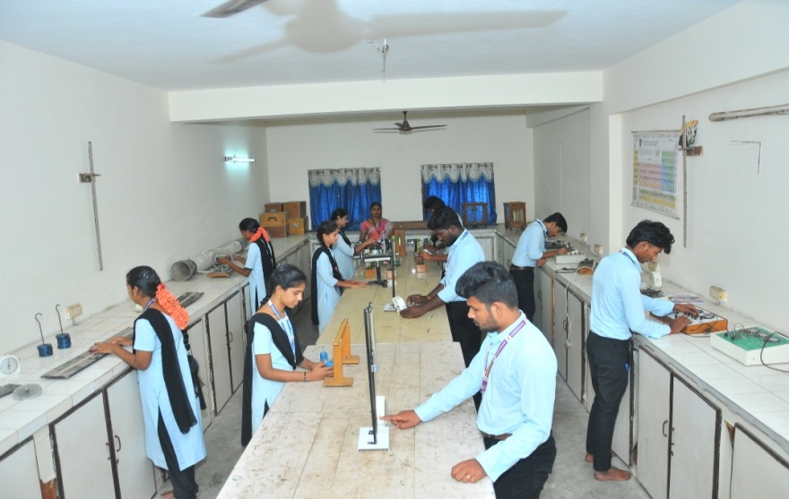
Students performing Physics Laboratory - experiment

